Slide 1


Intelligent Document Analysis
Leveraging LLMs for Enterprise-Grade RAG Solutions
Presented by Team ERROR-404
Notes:
1

Slide 2
About Us
We are AI and machine learning enthusiasts from Jodhpur Institute of Engineering and Technology (Batch 2027), passionate about designing scalable, real-world solutions for complex challenges. Our expertise spans computer vision, reinforcement learning, LLMs, and robust system design.
Members:
Apaar Mathur
Daksh Sharma
Aryan Jain
Projects
Hackathons
Fluxion: AI-powered traffic management system using computer vision, RL, and RNNs to predict congestion and dynamically optimize traffic signals in real time.
Runner-up | Smart India Hackathon 2024 – Recognized by the Ministry of Education’s Innovation Cell for our innovative, real-time traffic management solution.
RAG Pipeline: Multimodal financial report analysis using Claude Sonet 3.5 and Pathway, integrating structured and unstructured data for rapid, insightful analysis via a Streamlit interface.
Participant | LNMHACKS 7.0 (2025) – Showcased advanced AI-driven document processing workflows to peers and industry experts.
Notes:
2

Slide 3
Problem Statement: Intelligent Document Query
This project aims to build an LLM-powered intelligent query-retrieval system that can process large, complex documents—such as PDFs, DOCX, emails, and contracts—and answer natural language queries with precision. Designed for insurance, legal, HR, and compliance domains, it uses semantic search, clause retrieval, and explainable reasoning to deliver accurate, structured JSON responses. For example, given “Does this policy cover knee surgery, and what are the conditions?”, the system pinpoints the relevant clauses, explains its decision, and outputs results ready for both human review and system integration.
Notes:
3

Slide 4
Solution Overview: Production-Ready RAG
Our solution is a comprehensive Retrieval-Augmented Generation (RAG) system designed for intelligent document analysis, robustly deployed on the Google Cloud Platform. This architecture ensures high availability, scalability, and performance, making it suitable for enterprise-level applications.
Document Ingestion
Embedding Generation
Query Processing
LLM Answer Generation
1
2
3
4
5
6
7
Smart Parsing
Vector Storage
Contextual Retrieval
<30s
99.9%
Multi-format
Cloud-Native
Response Time
Uptime
Document Support
Scalable Architecture
Rapid query resolution for critical decisions.
Ensuring continuous, reliable service availability.
Versatile handling of diverse document types.
Built for flexible and efficient resource scaling.
Notes:
4

Slide 5
Tech Stack: Robust Foundations
Backend Framework
AI/ML Stack
FastAPI: High-performance REST API development.
LlamaParse: Advanced PDF parsing for complex layouts.
Uvicorn: ASGI server for asynchronous operations.
LlamaIndex: Connects LLMs to data for smart retrieval.
Pydantic: Data validation and settings management.
SentenceTransformers: Efficient text embeddings.
SQLAlchemy: Robust ORM for database interactions.
Groq: High-performance LLM inference.
Transformers: Hugging Face library for AI models.
Cloud Infrastructure
Database & Storage
Google Cloud Run: Serverless container deployment.
Pinecone: High-performance vector database.
Container Registry: Secure Docker image storage.
PostgreSQL: Reliable query logging and auditing.
Cloud Build: CI/CD pipeline automation.
Cloud SQL: Managed relational database service.
Docker: Containerization for consistent environments.
Notes:
5

Slide 6

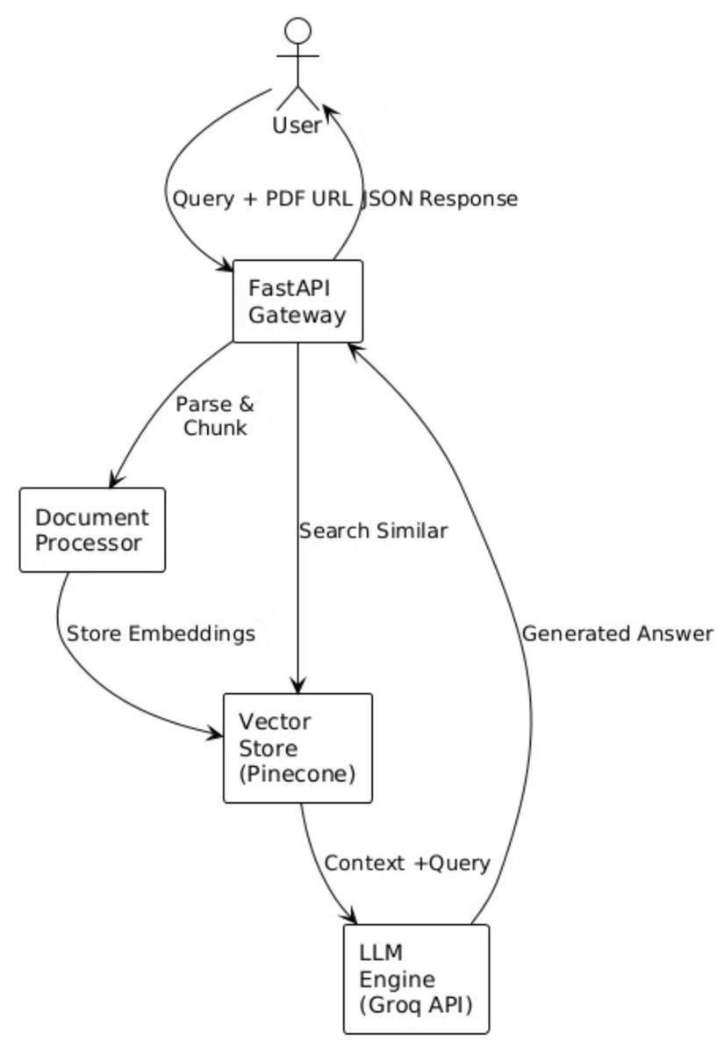
Architecture: End-to-End Flow
System Architecture
Notes:
6

Slide 7





Unique Selling Points: Differentiating Our Solution
Our RAG solution stands out through a combination of performance, intelligent processing, and enterprise-grade features. We have engineered specific optimizations and integrated best-in-class technologies to deliver a superior document analysis experience.
Document Caching & Reprocessing Avoidance
Intelligent caching mechanism prevents redundant processing of documents, enhancing efficiency.
Advanced Parsing with LlamaParse
Supports diverse file types, accurately captures text, organises logically, preserves text placement, recognises characters, and effectively separates sections.
Sub-second Response Times
Achieved through optimized chunking, efficient vector search, and the high-speed inference capabilities of Groq.
Multi-layered Intelligence
A powerful synergy of LlamaParse for parsing, Pinecone for vector search, and Groq for LLM inference.
Cosine Similarity for Contextual Retrieval
Utilizes cosine similarity to accurately find text chunks most relevant to user queries, ensuring highly contextual data retrieval.
Notes:
7

Slide 8
Future Enhancements: Expanding Capabilities
Our roadmap includes advanced features and integrations to further enhance the system's intelligence, performance, and enterprise readiness, continuously evolving to meet growing demands.
Core Intelligence
Analytics & Integration
Performance & Enterprise Features
Multi-modal processing (images, tables, charts)
Query pattern analysis & predictive compliance alerts
Real-time streaming & GPU-accelerated inference
Cross-document relationship mapping
CRM integration for streamlined workflows
Hybrid search combining semantic and keyword methods
Multi-tenant architecture with RBAC
Document management APIs
Comprehensive audit trails
Multi-language support
Workflow automation
Data sovereignty options
Notes:
8

Slide 9
Risks, Challenges & Dependencies
While confident in our solution, we acknowledge potential hurdles. Proactive identification and mitigation strategies are crucial for successful deployment and long-term operation.
Potential Risks & Challenges
Potential Showstoppers
Data Quality: Variations across sources.
Third-party Dependencies: API reliance.
Mitigation: Robust preprocessing & validation.
Solution: Fallbacks, SLAs, multi-provider setup.
Cost Scalability: Rising infra costs.
Cold Start Latency: Startup delays.
Mitigation: Caching, batching, resource monitoring.
Solution: Keep-alives, min instance provisioning, image optimisation.
Security & Compliance: Strict protocols.
Mitigation: Encryption, strong auth, audit logging.
Notes:
9

Slide 10
Acceptance Criteria: Fulfilled
Problem Statement Compliance
100% Format Support: Full handling of PDFs, DOCX, and emails.
Complete Technical Specs: All requirements implemented.
Production-Ready: Robust, scalable, and stable.
All Domains: Insurance, legal, HR, compliance.
Input Requirements Met
Technical Specifications
Advanced PDF parsing and seamless DOCX integration.
Pinecone Vector DB for high-performance semantic search.
Full email (content & attachments) processing.
Context-aware retrieval & clause matching.
Legal document optimisation.
Explainable LLM reasoning.
Natural language query processing.
Structured JSON outputs.
Domain Coverage
Advanced Features
Insurance: Policy analysis & claims.
Context-aware queries.
Legal: Contract review & research.
Logging & analytics.
HR: Document management & policy adherence
High-performance optimisation.
Cloud-native scalability.
Notes:
10

Slide 11
Live Demo & API Integration
Sample Interaction
Input Payload:
Output Response:
{ "documents": "https://example.com/health_policy.pdf", "questions": [ "Does this policy cover knee surgery, and what are the conditions?", "What is the maximum coverage limit for surgical procedures?", "What documents are required for filing a claim?" ]}
{ "answers": [ "Yes, knee surgery is covered under Section 3.2 - Surgical Benefits. Conditions: Pre-authorization required, 30-day waiting period for non-emergency procedures, and coverage up to ₹2,00,000 annually.", "The maximum coverage limit for surgical procedures is ₹5,00,000 per policy year as stated in Schedule of Benefits, with sub-limits varying by procedure type.", "Required documents: Claim form, medical reports, surgeon's certificate, hospital bills, discharge summary, and photo ID as per Section 7 - Claims Procedure." ]}
API Endpoints
POST /hackrx/run
GET /health
GET /docs
Process documents and receive answers to your natural language queries.
Check the system's operational status and uptime for real-time monitoring.
Access the comprehensive Swagger UI for detailed API documentation and testing.
Notes:
11

Slide 12
Seamless Deployment, Real-time Monitoring
Our robust infrastructure and efficient operations ensure high availability and optimal performance for your intelligent document analysis solution.
Cloud Deployment
Performance Metrics
Google Cloud Run: Auto-scaling, 4 GB RAM, 4 CPU, 1-hour timeout.
<30s
99.5%
CI/CD: Automated Cloud Build deployments from GitHub via Container Registry.
Average Response Time
System Success Rate
Monitoring: Health checks, logging, custom metrics, proactive alerts.
$50/month
100+
Cost Optimisation: Pay-per-use, intelligent batching, caching, and right-sizing.
Estimated Operating Cost
Concurrent User Support
Notes:
12

Slide 13




Beyond the Core: Our Differentiators & Future Outlook
Our solution not only tackles the immediate challenge but also provides significant advantages, ensuring long-term value and robust growth potential.
Our Unique Edge
Tangible Business Value
Runner-up at SIH 2024: Recognised for innovation.
ROI: 90% reduction in document review time.
AI/ML, Computer Vision, RAG Expertise: Deep technical mastery.
Accuracy: Significantly reduces human errors.
Enterprise-Ready Deployment: Built for scale and stability.
Scalability: Has the potential to handle hundreds of documents with ease
Innovative Approach: Pushing the boundaries of document analysis.
Built for Scalability
Partnership Potential
GitHub Repository: Full documentation and code access.
API Integration: Easy embedding into existing workflows.
Dockerized Deployment: Consistent and portable environments.
Multi-Tenant SaaS: Supports diverse client needs.
Notes:
13

Slide 14

Thank You
Team ERROR-404 | Jodhpur Institute of Engineering and Technology
Notes:
14

